Slide 1
Activation Functions

Slide 2
Neural Networks
Recall that inputs x have a weight w and a bias term b attached to them in the perceptron model.
Which means we have
x*w + b

Slide 3
Neural Networks
Which means we have
x*w + b
Clearly w implies how much weight or strength to give the incoming input.
We can think of b as an offset value, making x*w have to reach a certain threshold before having an effect.

Slide 4
Neural Networks
For example if b= -10
x*w + b
Then the effects of x*w won’t really start to overcome the bias until their product surpasses 10.
After that, then the effect is solely based on the value of w.
Thus the term “bias”

Slide 5
Neural Networks
Next we want to set boundaries for the overall output value of:
x*w + b
We can state:
z = x*w + b
And then pass z through some activation function to limit its value.

Slide 6
Neural Networks
A lot of research has been done into activation functions and their effectiveness.
Let’s explore some common activation functions.

Slide 7
Perceptron model
w1
x1
y
Inputs
f(X)
Output
w2
+b
x2
Recall our simple perceptron has an f(X)

Slide 8
Perceptron model
w1
x1
y
Inputs
f(X)
Output
w2
+b
x2
If we had a binary classification problem, we would want an output of either 0 or 1.

Slide 9
Neural Networks
To avoid confusion, let’s define the total inputs as a variable z.
Where z = wx + b
In this context, we’ll then refer to activation functions as f(z).
Keep in mind, you will often see these variables capitalized f(Z) or X to denote a tensor input consisting of multiple values.

Slide 10
Deep Learning
The most simple networks rely on a basic step function that outputs 0 or 1.
1
Output
0
0
z = wx + b

Slide 11
Deep Learning
Regardless of the values, this always outputs 0 or 1.
1
Output
0
0
z = wx + b

Slide 12
Deep Learning
This sort of function could be useful for classification (0 or 1 class).
1
Output
0
0
z = wx + b

Slide 13
Deep Learning
However this is a very “strong” function, since small changes aren’t reflected.
1
Output
0
0
z = wx + b

Slide 14
Deep Learning
There is just an immediate cut off that splits between 0 and 1.
1
Output
0
0
z = wx + b

Slide 15
Deep Learning
It would be nice if we could have a more dynamic function, for example the red line!
1
Output
0
0
z = wx + b

Slide 16
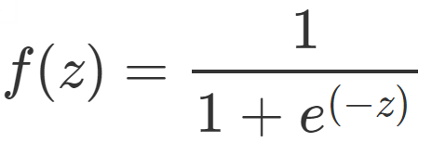
Deep Learning
Lucky for us, this is the sigmoid function!
1
Output
0
0
z = wx + b

Slide 17
Deep Learning
Changing the activation function used can be beneficial depending on the task!
1
Output
0
0
z = wx + b

Slide 18
Deep Learning
This still works for classification, and will be more sensitive to small changes.
1
Output
0
0
z = wx + b

Slide 19
Deep Learning
Let’s discuss a few more activation functions that we’ll encounter!
1
Output
0
0
z = wx + b

Slide 20
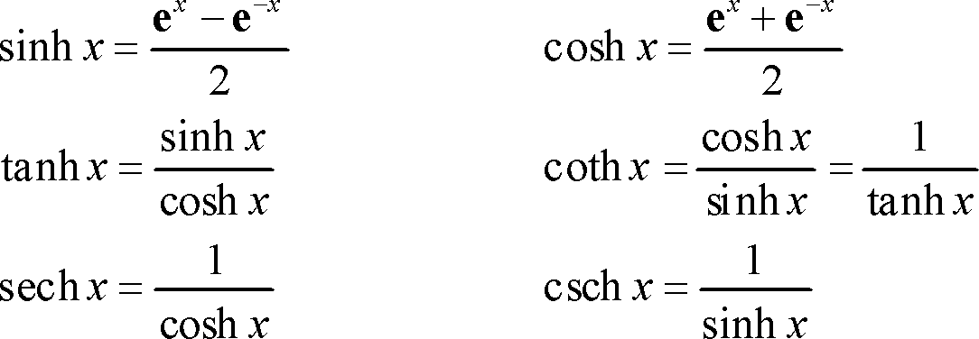
Deep Learning
Hyperbolic Tangent: tanh(z)
1
Output
-1
0

Slide 21
Deep Learning
Hyperbolic Tangent: tanh(z)
Outputs between -1 and 1 instead of 0 to 1
1
Output
-1
0

Slide 22
Deep Learning
Rectified Linear Unit (ReLU): This is actually a relatively simple function: max(0,z)
Output
0
z = wx + b

Slide 23
Deep Learning
ReLu has been found to have very good performance, especially when dealing with the issue of vanishing gradient.
We’ll often default to ReLu due to its overall good performance.

Slide 24
Deep Learning
For a full list of possible activation functions check out:
en.wikipedia.org/wiki/Activation_function

